Slide 1
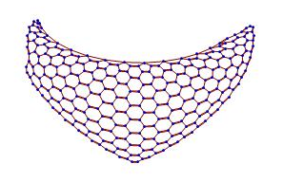
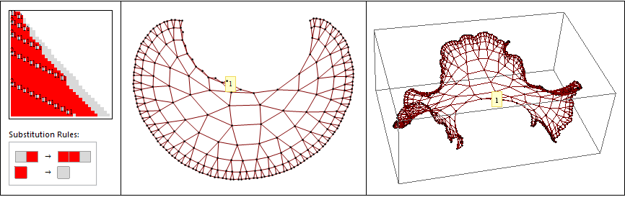
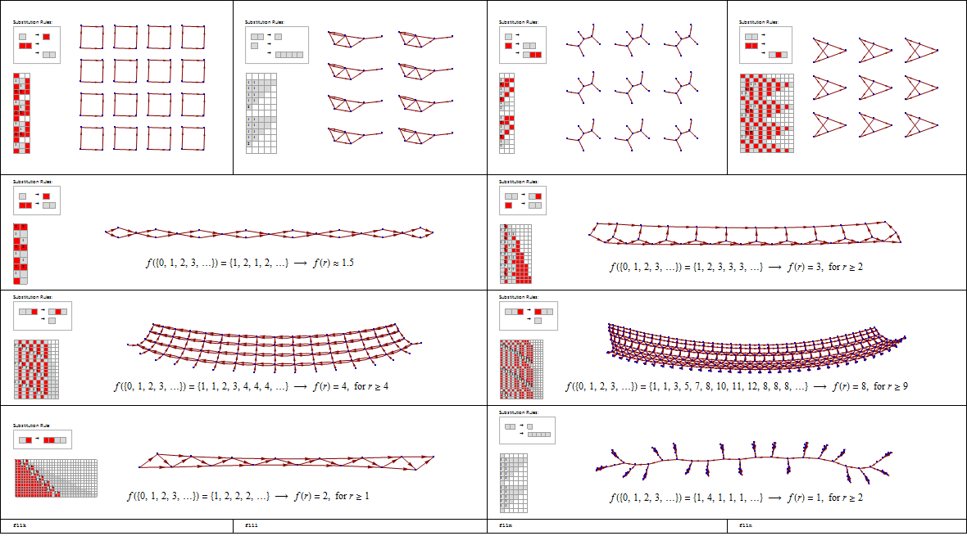
SESSIE NetWorks
Causal networks of SSSs
(Sequential Substitution Systems)
Pattern Hunting!

Slide 2















Engineering
Engineering
Mathematics
Biophysics
Mathematics
Math/Chemistry
W11
W10
W12
F14
W18
W20
Breanna Bowden-Green
Kelsey Dobbs
Amy Bead
Christen Case
Camille Morrow
Victoria Kratzke
1. Human inspection of networks.
2. Mathematical treatment of network properties.
3. Improved enumeration & acceleration.
Nursing
Biochemistry
Mathematics
Researchers in the SESSIE project Southern Adventist University
F16
W17
W20
Lucas Valenca
Drew Blake
Sarah Wu
4. Logic & Planning
Computer Sci. & Embedded Sys.
Physics
Bio/Premed
Biophys/Spanish
W20
W21
S19
W19
W19
Josh Wade
Jonathan Ziesmer
Miro Manestar
Jade Deschamps
Jeanna Toulouse
Christofer Trana
6. Translation
7. Identifying Networks Mathematically
5. Programming

Slide 3
Simple Rules → Complex Behavior
Strategy:
Take all possible sets of simple rules
Apply them repeatedly
Look for complex behavior
Features similar to the real universe?

Slide 4
Simple Rules → Complex Behavior
But this just raises more questions!
What is a “sessie”? (sequential substitution system)
What is a “ruleset”?
How does a ruleset govern the creation of a sessie and its causal network?

Slide 5
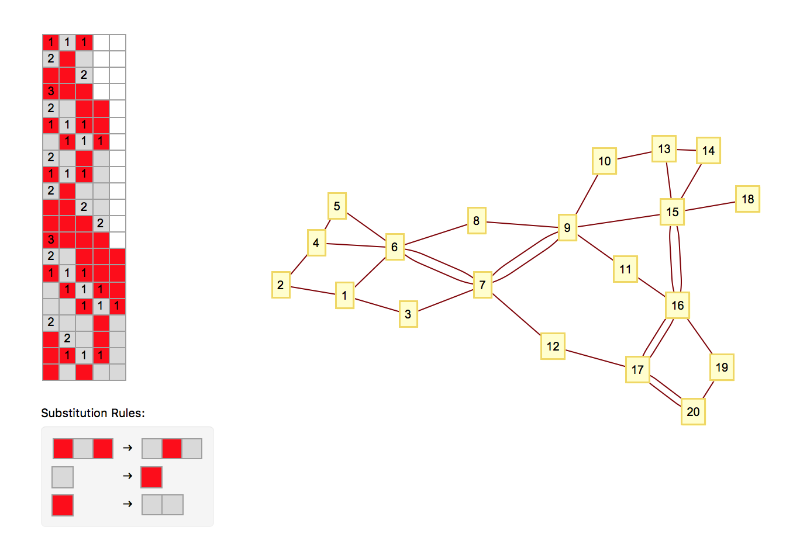
What is a Sessie?
Crash Course in Sessies:
This is a “S.e.S.S.i.e” (Sequential Substitution System)
Three Basic Components:
The “Sessie” (the colored grid)
The Ruleset
The Network (yellow boxes = nodes, lines = connections)

Slide 6
What is a Sessie?
BAB
ABA
BBA
BBB
AABB
BABB
ABAB
AABA
BABA
ABAA
BBAA
BBBA
BBBB
AABBB
BABBB
ABABB
AABAB
AAABA
BAABA
BBABA
BABAA
Crash Course in Sessies:
Actually the colored boxes are just to provide a quick visualization, internally we have an unbounded alphabet of characters, from which we make strings of any length:
BAB → ABA
A → B
B → AA

Slide 7
Crash Course in building Sessies:
1. Rules cause Sessies to change.
They destroy old blocks and exchange them for new blocks. (Time flows downwards in the Sessie display.)
2. We use only 1 rule per row, and
use the 1st rule that works, in the 1st position where it works (reading left to right)
3. A Yellow Box (Node) in the network means a rule was used.
Gray lines link some nodes. (Which connections are made will be introduced later).
Sessie (aka a grid of cells)
Node 1
Node 2
Node 3
Node 4
And so on
Yellow box 1 w/ Node 1, Box 2 w/ Node 2… and so on.

Slide 8
You can start with any state string. This one is “BAB”. (Red-Gray-Red corresponds to B-A-B)
Rule 1 matches here.
Rule 1
We only use the first “substitution rule” that works.
Notes:
No rules used: only state string: no nodes

Slide 9
Numbers convey that Rule 1 matched with these cells
rule applications occur “between” rows
1 Rule application → creates 1 node
Exchanging the old row, for this new one below it.
Node 1
Rule 1
Notes:
1 node from 1 rule used

Slide 10
Node 2
Which rule would we use next?
Why are they connected?
Node 2
When new node exchanges the blocks of an old node, a line links the nodes!
Implications:
Each rule application adds 1 new node, each destruction of a older block adds 1 connection.
Question: What about the rule that destroys 3 blocks?
Answer: 1 new node, 3 new connections!
Notes:
2 rules used: 2 connected nodes
CONNECTED – 1 cell created by event 1, destroyed by event 2
Identify: what rule was used in row 2? - second rule (see “2” in row 2)
→ Single connection

Slide 11


Node 1
Node 2
Node 3
Rule 2
So, given , what rule would we use for Node 3?
Remember:
Read Sessie L from R
Use the first rule that works
Applying this rule “creates” node 3.
Rule 2
Notes:
2 rules used: 2 connected nodes
CONNECTED – 1 cell created by event 1, destroyed by event 2
Identify: what rule was used in row 2? - second rule (see “2” in row 2)
→ Single connection

Slide 12
Rule 2
If node 1 created a block,
and node 3 replaced that block,
then they must be connected.
T
This is this is the basic premise of building Sessies.
Notes:
Identify- nodes 1 and 3 are connected.

Slide 15
3 Links at once!!
See “ 1 1 1”
Let’s go back to our previous implication:
“Let’s say a new node destroyed 2 older blocks, but, these blocks came from two different nodes. How many links would the new node have?”
Notes:
Row 6: 1 1 1 : replaced 3 nodes that were originally formed from 3 different places

Slide 16
Here we have Node 7 connected twice to Node 6, once to Node 3. Why might that be?
Simply because Node 7 exchanged two blocks that came from Node 6, one that came from Node 3.
Notes:
6 created 2 cells that 7 destroyed: therefore, 2 connections.
Let’s find them on the sessie grid.

Slide 30
Simple Rules → Complex Behavior
We have answered the questions – kinda, sorta!
What is a “sessie”? (sequential substitution system)
What is a “ruleset”?
How does a ruleset govern the creation of a sessie and its causal network?
✓
✓
✓

Slide 31
Rule Sets → Sessies → Networks

Slide 32
Different Rule Sets → Different Sessies → Different Networks

Slide 33
Different Rule Sets → Different Sessies → Different Networks

Slide 34
Different Rule Sets → Different Sessies → Different Networks

Slide 35
Network dimension
0: Does not extend in any direction
No network or dies out
Infinitely repeating separate clumps, increasingly complex

Slide 36
Network dimension
0: Does not extend in any direction
1: Extends in only one direction
May have more dimensions on small scale
Like the hidden dimensions of String Theory

Slide 37
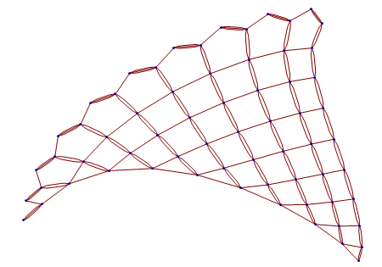
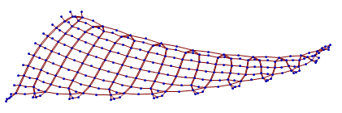
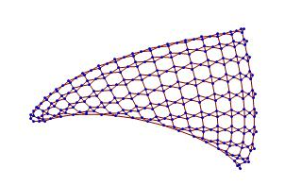
Network dimension
2: Extends (forever) in two directions

Slide 38
Network dimension
3: Three-dimensional growth?
Maybe not, getting infinitely dense → Exponential Growth

Slide 39
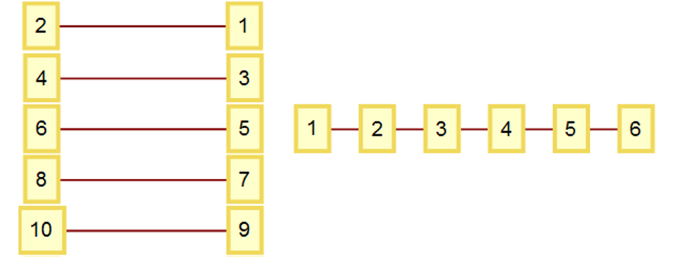
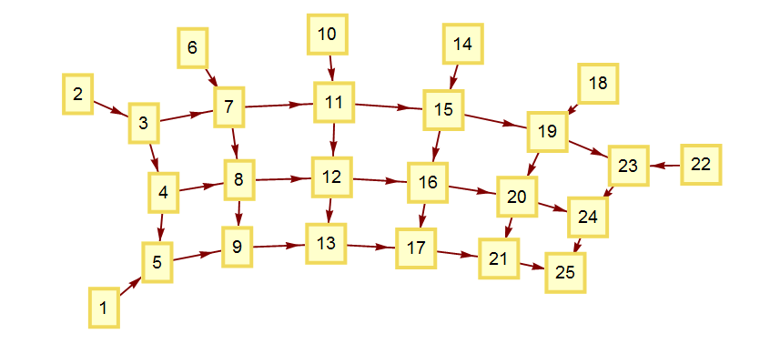
Identifying Networks
Mathematically!
Check whether it’s new or not
Jeanna Toulouse
W19
Christofer Trana
W19
Any 1-d network “summarized” compactly:
Another example:
Network | {1→2, 3→4, 5→6, 7→8, …} | {1→2, 2→3, 3→4, 5→6, …}
Link Length Set List | {{1},{},{1},{},{1},{},{1},{},{1},{},…} | {{1},{1},{1},{1},{1},…}
Summary | {{1},{}} | {{1}}
Network | {{1→5, 2→3, 3→4, 3→7, 4→5, 4→8, 5→9, 6→7, 7→8, 7→11, 8→9, 8→12, 9→13, 10→11, 11→12, 11→15, 12→13, 12→16, 13→17, 14→15, 15→16, 15→19, 16→17, 16→20, 17→21, 18→19, 19→20, 19→23, 20→21, 20→24, 21→25, 22→23, 23→24, 24→25}}
Link Length Set List | {{4}, {1}, {1,4}, {1,4}, {4}, {1}, {1,4}, {1,4}, {4}, {1}, {1,4}, {1, 4}, {4}, {1}, {1,4}, {1,4}, {4}, {1}, {1,4}, {1,4}, {4}, {1}, {1}, {1}}
Summary | {{4}, {1}, {1,4}, {1,4}}

Slide 40
Simple Rules → Complex Behavior
Strategy:
Take all possible sets of simple rules
Apply them repeatedly
Look for complex behavior
Features similar to the real universe?
But HOW?

Slide 41
Enter…
The Complete Enumeration
of ALL Rulesets
But wait, aren’t there an infinite number of these rulesets?
Multiple infinities!
Any number of rules, any length strings, any characters

Slide 42
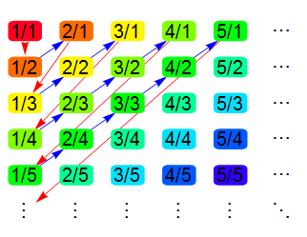
List of all possible FRACTIONS
Inspired by Cantor’s enumeration of all fractions

Slide 43
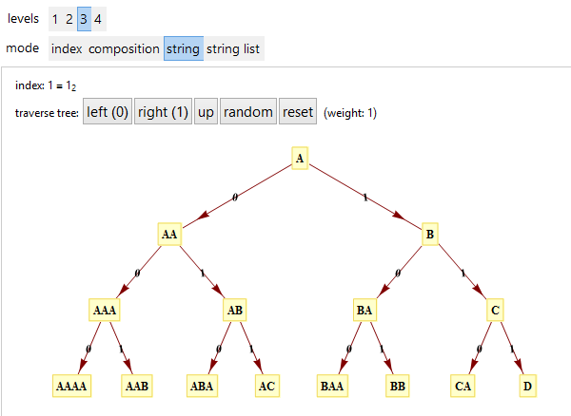
List of all possible STRINGS
Inspired by Cantor’s enumeration of all fractions
Universal String Enumeration aka Tree of All Strings
http://demonstrations.wolfram.com/UniversalStringEnumeration/
http://demonstrations.wolfram.com/TreeOfStrings/

Slide 44
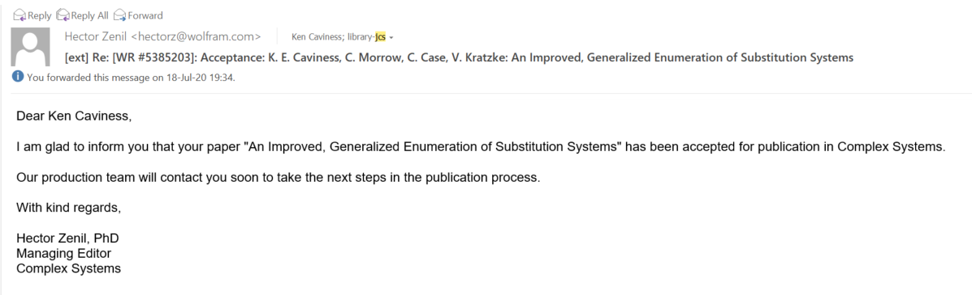
List of all possible rule sets
Inspired by Cantor’s enumeration of all fractions
Universal String Enumeration aka Tree of All Strings
http://demonstrations.wolfram.com/TreeOfStrings/
Enumeration of all SSS rule sets
http://www.mathematica-journal.com/ 2011/05/indexing-strings-and-rulesets/
Improved Generalized SS Enumeration
Just accepted for publication!
KC, Christen Case (SAU 2015), Camille Morrow Gonzalez (SAU 2018), Victoria Kratzke (SAU 2020)

Slide 45
Improved SS Enumeration
allows massive acceleration
millions of times faster!
Christen Case
F14
Camille Morrow
W18
Victoria Kratzke
W20
Base-5 digit meanings:
0. End this string, insert two empty strings, start a new string with an “A”.
1. End this string, insert one empty string, start a new string with an “A”.
2. End this string and start a new string with an “A”.
3. End this character and start a new character (as an “A”).
4. Increment this character.

Slide 46
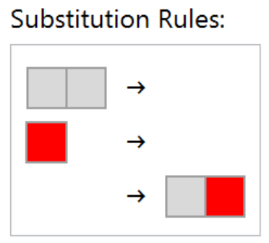
A simple example
Let’s build this ruleset from its base-5 code identifier:
The subscript “5” (base) reminds us that are only 5 allowed digits:
0, 1, 2, 3, 4
Each digit has a precise significance for constructing the ruleset, and this base-5 code identifies and results in one unique ruleset.
314034₅
Notes:
All sessies are generated from sets of substitution rules, and every ruleset corresponds to a unique code number. Let’s build this ruleset …

Slide 47
Base-5 digit meanings:
0. End this string, insert two empty strings and start a new string with an “A”.
1. End this string, insert one empty string and start a new string with an “A”.
2. End this string and start a new string with an “A”.
3. End this character and start a new character (as an “A”).
4. Increment this character.
A simple example: 314034
Ruleset under construction:
Start: {“A”}
Notes:
A simple one, but containing the digits 0 and 1. Again, start with a single A.

Slide 48
Base-5 digit meanings:
0. End this string, insert two empty strings and start a new string with an “A”.
1. End this string, insert one empty string and start a new string with an “A”.
2. End this string and start a new string with an “A”.
3. End this character and start a new character (as an “A”).
4. Increment this character.
A simple example: 314034
Ruleset under construction:
{“A”}
=> {“AA”}
Notes:
Append

Slide 49
Base-5 digit meanings:
0. End this string, insert two empty strings and start a new string with an “A”.
1. End this string, insert one empty string and start a new string with an “A”.
2. End this string and start a new string with an “A”.
3. End this character and start a new character (as an “A”).
4. Increment this character.
A simple example: 314034
Ruleset under construction:
{“AA”}
=> {“AA”->“”, “A”}
Notes:
1 means “insert an empty string, then start a new string with a single A”

Slide 50
Base-5 digit meanings:
0. End this string, insert two empty strings and start a new string with an “A”.
1. End this string, insert one empty string and start a new string with an “A”.
2. End this string and start a new string with an “A”.
3. End this character and start a new character (as an “A”).
4. Increment this character.
A simple example: 314034
Ruleset under construction:
{“AA”->“”, “A”}
=> {“AA”->“”, “B”}
Notes:
Increment

Slide 51
Base-5 digit meanings:
0. End this string, insert two empty strings and start a new string with an “A”.
1. End this string, insert one empty string and start a new string with an “A”.
2. End this string and start a new string with an “A”.
3. End this character and start a new character (as an “A”).
4. Increment this character.
A simple example: 314034
Ruleset under construction:
{“AA”->“”, “B”}
=> {“AA”->“”, “B”->“”, “”->“A”}
Notes:
0 means “insert 2 empty strings, then a new string starting with an A”

Slide 52
Base-5 digit meanings:
0. End this string, insert two empty strings and start a new string with an “A”.
1. End this string, insert one empty string and start a new string with an “A”.
2. End this string and start a new string with an “A”.
3. End this character and start a new character (as an “A”).
4. Increment this character.
A simple example: 314034
Ruleset under construction:
{“AA”->“”, “B”->“”, “”->“A”}
=> {“AA”->“”, “B”->“”, “”->“AA”}
Notes:
Append

Slide 53
Base-5 digit meanings:
0. End this string, insert two empty strings and start a new string with an “A”.
1. End this string, insert one empty string and start a new string with an “A”.
2. End this string and start a new string with an “A”.
3. End this character and start a new character (as an “A”).
4. Increment this character.
A simple example: 314034
Ruleset under construction:
{“AA”->“”, “B”->“”, “”->“AA”}
=> {“AA”->“”, “B”->“”, “”->“AB”}
Notes:
Increment

Slide 54
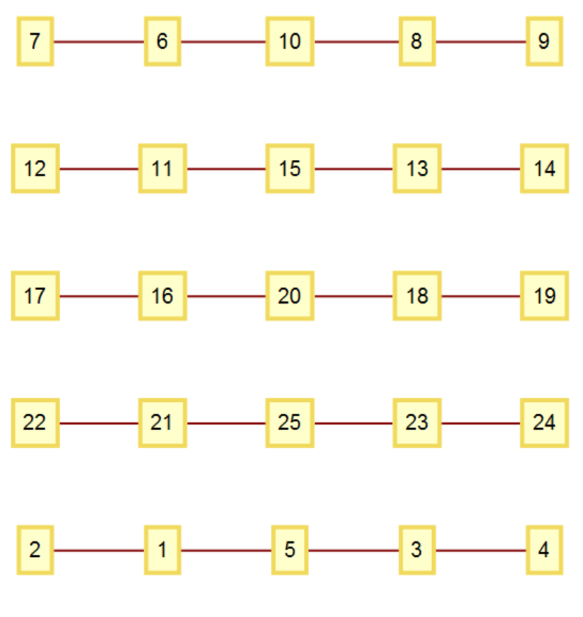
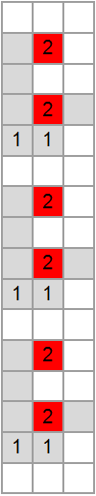
Base-5 digit meanings:
0. End this string, insert two empty strings and start a new string with an “A”.
1. End this string, insert one empty string and start a new string with an “A”.
2. End this string and start a new string with an “A”.
3. End this character and start a new character (as an “A”).
4. Increment this character.
A simple example: 314034
Ruleset under construction:
{“AA”->“”, “B”->“”, “”->“AB”}
DONE!
Notes:
Done. Although this simpler ruleset generates a rather simple repetitive sessie and network, as shown here.

Slide 55
List of all possible rule sets
A more complicated example…

Slide 56
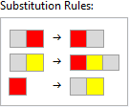
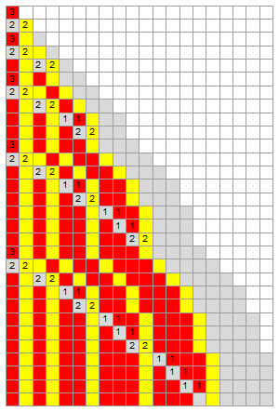
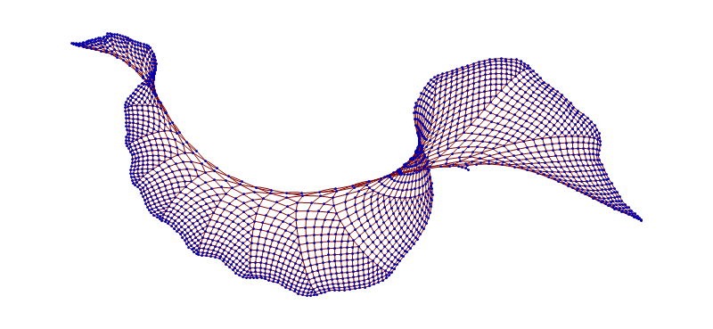
Our first 3-d network: {"AB"->"BA", "AC"->"BCA", "B"->"AC"}
Notes:
Or start filling up a 3rd dimension. This could be arranged to evenly fill a growing cone-shape in 3 dimensions, but it does need 3-d.

Slide 57
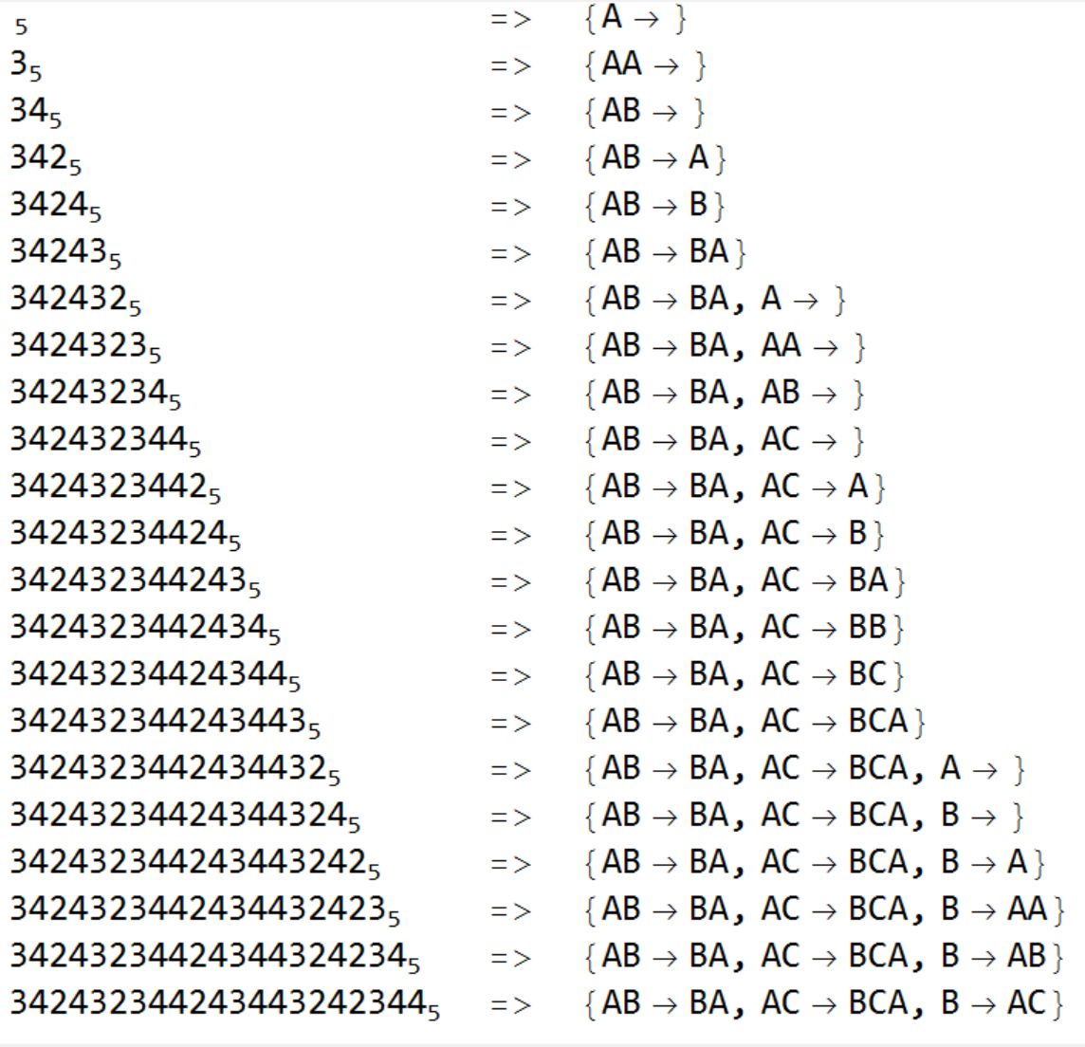
Base-5 digit meanings:
0. End this string, insert two empty strings and start a new string with an “A”.
1. End this string, insert one empty string and start a new string with an “A”.
2. End this string and start a new string with an “A”.
3. End this character and start a new character (as an “A”).
4. Increment this character.
Too Fast!
Base-5 Code: Ruleset under construction:
Notes:
Camille, can you make the window at the bottom scroll up?
After all the code digits are scanned, the complete ruleset has been built. Wait, that was too fast!

Slide 58
Base-5 digit meanings:
0. End this string, insert two empty strings and start a new string with an “A”.
1. End this string, insert one empty string and start a new string with an “A”.
2. End this string and start a new string with an “A”.
3. End this character and start a new character (as an “A”).
4. Increment this character.
Digit being treated: 342432344243443242344
Ruleset under construction:
Start: {“A”}
Notes:
Let’s look at it one step at a time. Even before we look at any of the digits, we start the ruleset with a single “A”.

Slide 59
Base-5 digit meanings:
0. End this string, insert two empty strings and start a new string with an “A”.
1. End this string, insert one empty string and start a new string with an “A”.
2. End this string and start a new string with an “A”.
3. End this character and start a new character (as an “A”).
4. Increment this character.
“Append”
“Increment”
Digit being treated: 342432344243443242344
Ruleset under construction:
{“A”}
=> {“AA”}
Notes:
3 means “append an A”

Slide 60
Base-5 digit meanings:
0. End this string, insert two empty strings and start a new string with an “A”.
1. End this string, insert one empty string and start a new string with an “A”.
2. End this string and start a new string with an “A”.
3. End this character and start a new character (as an “A”).
4. Increment this character.
“Append”
“Increment”
Digit being treated: 342432344243443242344
Ruleset under construction:
{“AA”}
=> {“AB”}
Notes:
4 means “increment the final character”

Slide 61
Base-5 digit meanings:
0. End this string, insert two empty strings and start a new string with an “A”.
1. End this string, insert one empty string and start a new string with an “A”.
2. End this string and start a new string with an “A”.
3. End this character and start a new character (as an “A”).
4. Increment this character.
“Append”
“Increment”
Digit being treated: 342432344243443242344
Ruleset under construction:
{“AB”}
=> {“AB”->“A”}
Notes:
2 means “end this string and start a new string with a single A”

Slide 62
Base-5 digit meanings:
0. End this string, insert two empty strings and start a new string with an “A”.
1. End this string, insert one empty string and start a new string with an “A”.
2. End this string and start a new string with an “A”.
3. End this character and start a new character (as an “A”).
4. Increment this character.
“Append”
“Increment”
Digit being treated: 342432344243443242344
Ruleset under construction:
{“AB”->“A”}
=> {“AB”->“B”}
Notes:
Increment the A to become a B

Slide 63
Base-5 digit meanings:
0. End this string, insert two empty strings and start a new string with an “A”.
1. End this string, insert one empty string and start a new string with an “A”.
2. End this string and start a new string with an “A”.
3. End this character and start a new character (as an “A”).
4. Increment this character.
“Append”
“Increment”
Digit being treated: 342432344243443242344
Ruleset under construction:
{“AB”->“B”}
=> {“AB”->“BA”}
Notes:
Append an A

Slide 64
Base-5 digit meanings:
0. End this string, insert two empty strings and start a new string with an “A”.
1. End this string, insert one empty string and start a new string with an “A”.
2. End this string and start a new string with an “A”.
3. End this character and start a new character (as an “A”).
4. Increment this character.
“Append”
“Increment”
Digit being treated: 342432344243443242344
Ruleset under construction:
{“AB”->“BA”}
=> {“AB”->“BA”, “A”}
Notes:
Start a new string

Slide 65
Base-5 digit meanings:
0. End this string, insert two empty strings and start a new string with an “A”.
1. End this string, insert one empty string and start a new string with an “A”.
2. End this string and start a new string with an “A”.
3. End this character and start a new character (as an “A”).
4. Increment this character.
“Append”
“Increment”
Digit being treated: 342432344243443242344
Ruleset under construction:
{“AB”->“BA”, “A”}
=> {“AB”->“BA”, “AA”}
Notes:
Append an A

Slide 66
Base-5 digit meanings:
0. End this string, insert two empty strings and start a new string with an “A”.
1. End this string, insert one empty string and start a new string with an “A”.
2. End this string and start a new string with an “A”.
3. End this character and start a new character (as an “A”).
4. Increment this character.
“Append”
“Increment”
Digit being treated: 342432344243443242344
Ruleset under construction:
{“AB”->“BA”, “AA”}
=> {“AB”->“BA”, “AB”}
Notes:
Increment the A to become a B

Slide 67
Base-5 digit meanings:
0. End this string, insert two empty strings and start a new string with an “A”.
1. End this string, insert one empty string and start a new string with an “A”.
2. End this string and start a new string with an “A”.
3. End this character and start a new character (as an “A”).
4. Increment this character.
“Append”
“Increment”
Digit being treated: 342432344243443242344
Ruleset under construction:
{“AB”->“BA”, “AB”}
=> {“AB”->“BA”, “AC”}
Notes:
Increment the B to become a C

Slide 68
Base-5 digit meanings:
0. End this string, insert two empty strings and start a new string with an “A”.
1. End this string, insert one empty string and start a new string with an “A”.
2. End this string and start a new string with an “A”.
3. End this character and start a new character (as an “A”).
4. Increment this character.
“Append”
“Increment”
Digit being treated: 342432344243443242344
Ruleset under construction:
{“AB”->“BA”, “AC”}
=> {“AB”->“BA”, “AC”->“A”}
Notes:
Start a new string

Slide 69
Base-5 digit meanings:
0. End this string, insert two empty strings and start a new string with an “A”.
1. End this string, insert one empty string and start a new string with an “A”.
2. End this string and start a new string with an “A”.
3. End this character and start a new character (as an “A”).
4. Increment this character.
“Append”
“Increment”
Digit being treated: 342432344243443242344
Ruleset under construction:
{“AB”->“BA”, “AC”->“A”}
=> {“AB”->“BA”, “AC”->“B”}
Notes:
Increment

Slide 70
Base-5 digit meanings:
0. End this string, insert two empty strings and start a new string with an “A”.
1. End this string, insert one empty string and start a new string with an “A”.
2. End this string and start a new string with an “A”.
3. End this character and start a new character (as an “A”).
4. Increment this character.
“Append”
“Increment”
Digit being treated: 342432344243443242344
Ruleset under construction:
{“AB”->“BA”, “AC”->“B”}
=> {“AB”->“BA”, “AC”->“BA”}
Notes:
Append

Slide 71
Base-5 digit meanings:
0. End this string, insert two empty strings and start a new string with an “A”.
1. End this string, insert one empty string and start a new string with an “A”.
2. End this string and start a new string with an “A”.
3. End this character and start a new character (as an “A”).
4. Increment this character.
“Append”
“Increment”
Digit being treated: 342432344243443242344
Ruleset under construction:
{“AB”->“BA”, “AC”->“BA”}
=> {“AB”->“BA”, “AC”->“BB”}
Notes:
Increment

Slide 72
Base-5 digit meanings:
0. End this string, insert two empty strings and start a new string with an “A”.
1. End this string, insert one empty string and start a new string with an “A”.
2. End this string and start a new string with an “A”.
3. End this character and start a new character (as an “A”).
4. Increment this character.
“Append”
“Increment”
Digit being treated: 342432344243443242344
Ruleset under construction:
{“AB”->“BA”, “AC”->“BB”}
=> {“AB”->“BA”, “AC”->“BC”}
Notes:
Increment

Slide 73
Base-5 digit meanings:
0. End this string, insert two empty strings and start a new string with an “A”.
1. End this string, insert one empty string and start a new string with an “A”.
2. End this string and start a new string with an “A”.
3. End this character and start a new character (as an “A”).
4. Increment this character.
“Append”
“Increment”
Digit being treated: 342432344243443242344
Ruleset under construction:
{“AB”->“BA”, “AC”->“BC”}
=> {“AB”->“BA”, “AC”->“BCA”}
Notes:
Append

Slide 74
Base-5 digit meanings:
0. End this string, insert two empty strings and start a new string with an “A”.
1. End this string, insert one empty string and start a new string with an “A”.
2. End this string and start a new string with an “A”.
3. End this character and start a new character (as an “A”).
4. Increment this character.
“Append”
“Increment”
Digit being treated: 342432344243443242344
Ruleset under construction:
{“AB”->“BA”, “AC”->“BCA”}
=> {“AB”->“BA”, “AC”->“BCA”, “A”}
Notes:
Start a new string

Slide 75
Base-5 digit meanings:
0. End this string, insert two empty strings and start a new string with an “A”.
1. End this string, insert one empty string and start a new string with an “A”.
2. End this string and start a new string with an “A”.
3. End this character and start a new character (as an “A”).
4. Increment this character.
“Append”
“Increment”
Digit being treated: 342432344243443242344
Ruleset under construction:
{“AB”->“BA”, “AC”->“BCA”, “A”}
=> {“AB”->“BA”, “AC”->“BCA”, “B”}
Notes:
Increment

Slide 76
Base-5 digit meanings:
0. End this string, insert two empty strings and start a new string with an “A”.
1. End this string, insert one empty string and start a new string with an “A”.
2. End this string and start a new string with an “A”.
3. End this character and start a new character (as an “A”).
4. Increment this character.
“Append”
“Increment”
Digit being treated: 342432344243443242344
Ruleset under construction:
{“AB”->“BA”, “AC”->“BCA”, “B”}
=> {“AB”->“BA”, “AC”->“BCA”, “B”->“A”}
Notes:
Start a new string

Slide 77
Base-5 digit meanings:
0. End this string, insert two empty strings and start a new string with an “A”.
1. End this string, insert one empty string and start a new string with an “A”.
2. End this string and start a new string with an “A”.
3. End this character and start a new character (as an “A”).
4. Increment this character.
“Append”
“Increment”
Digit being treated: 342432344243443242344
Ruleset under construction:
{“AB”->“BA”, “AC”->“BCA”, “B”->“A”}
=> {“AB”->“BA”, “AC”->“BCA”, “B”->“AA”}
Notes:
Append

Slide 78
Base-5 digit meanings:
0. End this string, insert two empty strings and start a new string with an “A”.
1. End this string, insert one empty string and start a new string with an “A”.
2. End this string and start a new string with an “A”.
3. End this character and start a new character (as an “A”).
4. Increment this character.
“Append”
“Increment”
Digit being treated: 342432344243443242344
Ruleset under construction:
{“AB”->“BA”, “AC”->“BCA”, “B”->“AA”}
=> {“AB”->“BA”, “AC”->“BCA”, “B”->“AB”}
Notes:
Increment

Slide 79
Base-5 digit meanings:
0. End this string, insert two empty strings and start a new string with an “A”.
1. End this string, insert one empty string and start a new string with an “A”.
2. End this string and start a new string with an “A”.
3. End this character and start a new character (as an “A”).
4. Increment this character.
“Append”
“Increment”
Digit being treated: 342432344243443242344
Ruleset under construction:
{“AB”->“BA”, “AC”->“BCA”, “B”->“AB”}
=> {“AB”->“BA”, “AC”->“BCA”, “B”->“AC”}
Notes:
Increment

Slide 80
Base-5 digit meanings:
0. End this string, insert two empty strings and start a new string with an “A”.
1. End this string, insert one empty string and start a new string with an “A”.
2. End this string and start a new string with an “A”.
3. End this character and start a new character (as an “A”).
4. Increment this character.
“Append”
“Increment”
Base-5 code: 342432344243443242344
Ruleset constructed:
{“AB”->“BA”, “AC”->“BCA”, “B”->“AC”}
DONE!
Notes:
Every base-5 code number results in a unique sequential substitution system ruleset. But let’s look at another example, …

Slide 81
SESSIE NetWorks
Lots of opportunities for future research!
Sessie Research meetings? Email me if you’re interested
DONE!
(and so are we)
Have a good weekend! ☺

